Slide 1
Software Engineering Laboratory CS29006
Abir Das
Computer Science and Engineering Department
Indian Institute of Technology Kharagpur

Slide 2
Agenda
Getting familiar with some GUI programing concepts in Python
Assumption: You are already familiar with basics of Python e.g., conditions, loops, functions, different containers.

Slide 3
Sources
Materials for these slides are taken majorly from the following websites.
https://anzeljg.github.io/rin2/book2/2405/docs/tkinter/index.html
https://python-course.eu/tkinter/
A good youtube playlist to learn Tkinter from codemy.com
https://www.youtube.com/playlist?list=PLCC34OHNcOtoC6GglhF3ncJ5rLwQrLGnV

Slide 4
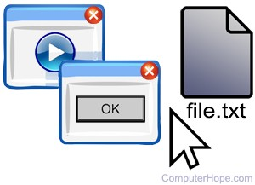
Graphical User Interface (GUI)
Wikipedia says – ‘The graphical user interface (GUI) is a form of user interface that allows users to interact with electronic devices through graphical icons and audio indicator such as primary notation, instead of text-based user interfaces, typed command labels or text navigation.’
Why GUI:
CLI (command line interface) can be intimidating to a beginner.
A picture is worth a thousand words!
Pic source: www.computerhope.com

Slide 5
Python GUIs
Tkinter: standard built-in Python GUI library. built on top of the Tcl/Tk widget set.
wxPython: wxWidgets is C++ based GUI library. wxPython is Python bindings for it.
PyQT: wraps Qt toolkit facilities.
PyObjc: Mac OS specific library.
PythonWin: set of wrappings used to create Windows based GUIs.

Slide 6
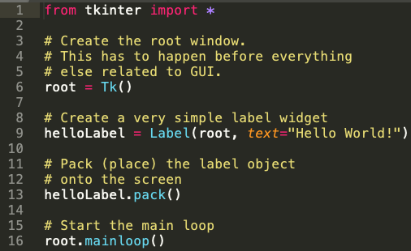
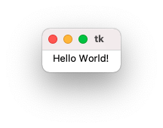
Fundamentals of Tkinter
General workflow:
Import Tkinter module
Create main GUI window
Create Widgets
Enter main eventloop
Place Widgets in main window
Notes:
Widgets are graphical objects displayed in the main window which is termed here as root. Some other languages refer to them as UI components. Examples of widgets are buttons, checkboxes, selection lists, labels text fields etc.

Slide 7
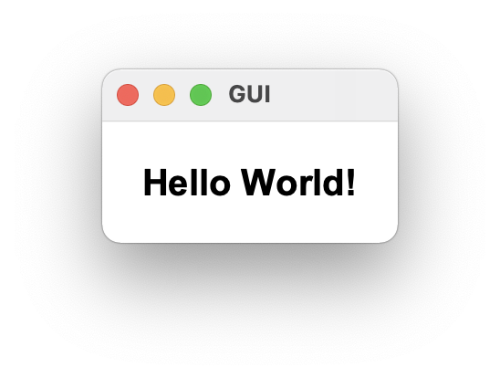


Label Widget
A label is used to display text or an image. The label widget is for just viewing, not for interacting with.
Many options to play with: ‘bg’, ‘fg’, ‘font’, ‘bd’, ‘image’ etc.
Comprehensive list: Tkinter reference. Link.

Slide 8
Layout/Geometry Manager in Tkinter
Arranges widgets in the main GUI window.
pack
grid
place
These three should never be mixed in the same master window!
‘pack’ is easiest to use but limited in capabilities. ‘packing’ widgets by default puts them below the other.
‘place’ allows explicit setting of position and size of widgets, either in absolute terms, or relative to another widget.

Slide 9
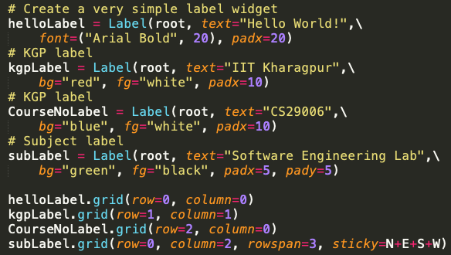
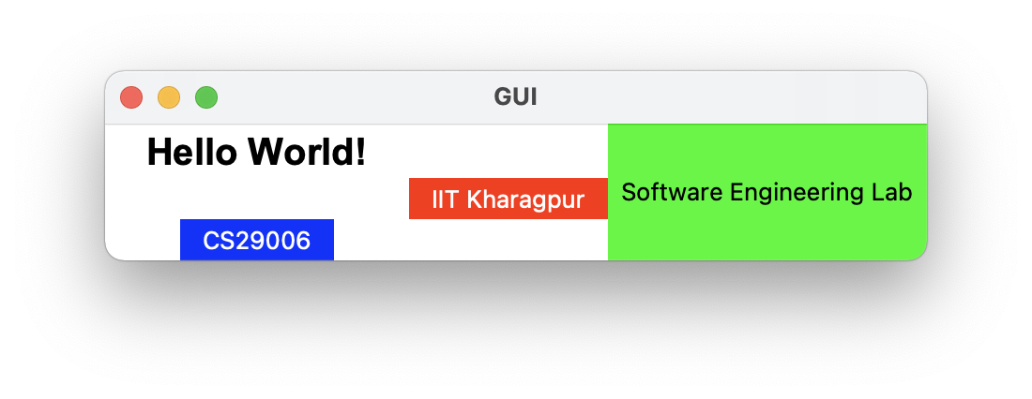
Layout/Geometry Manager in Tkinter
‘grid’ treats every window or frame as a table - a gridwork of rows and columns.
A cell is the area at the intersection of one row and one column.
The width of column is the width of widest cell in that column.
The height of row is the height of tallest cell in that row.
Notes:
Column and row numbers must be positive integers (i.e., 0, 1, 2, ...). You don't have to start at 0 and can leave gaps in column and row numbers (e.g., column 1, 2, 10, 11, 12, 20, 21).

Slide 10
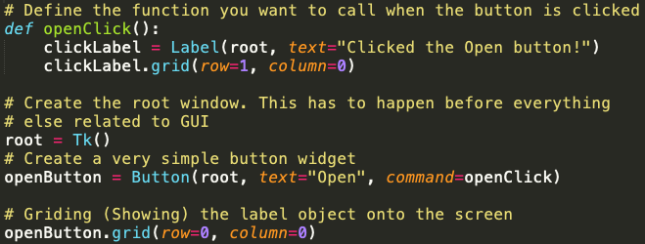
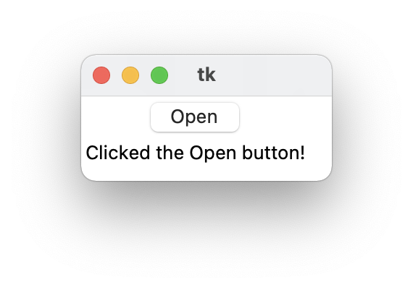
Button Widget
Button press initiates an event.
‘command’ action takes the function we need to execute on buttonpress as input.
Comprehensive list: Tkinter reference. Link

Slide 11
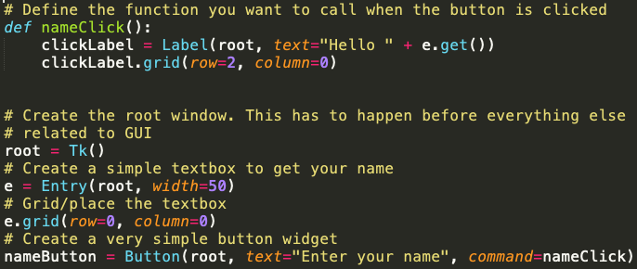
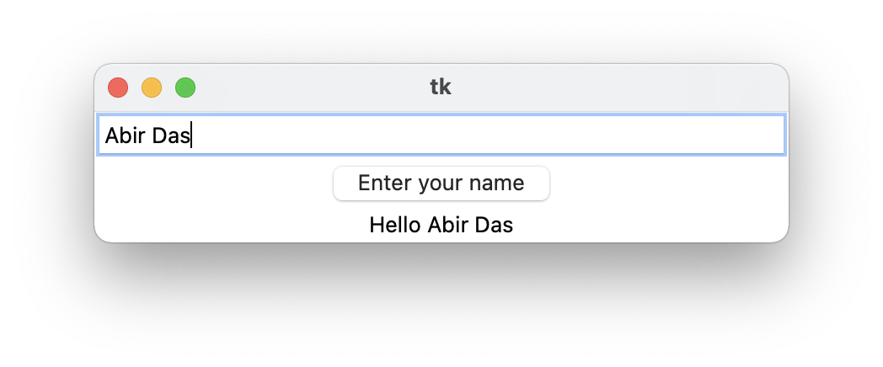
Textbox/Entry Widget
Entry widgets are used to get input, i.e. text strings, from user.
Some important methods of Entry object:
.get() – Get current text in ‘Entry’ as string
.insert(index, s) - Insert string ’s’ before the character at the given index.
.delete(first, last=None) - Delete characters starting at first, up to but not including position last.

Slide 12
For Assignment
You will need to play with Tkinter FileDialog.
You will need to play with Tkinter Combobox.
Display images in Label.
The assignment is based on the previous Python Data Science assignment.

Slide 13
Thank You

